Slide 1
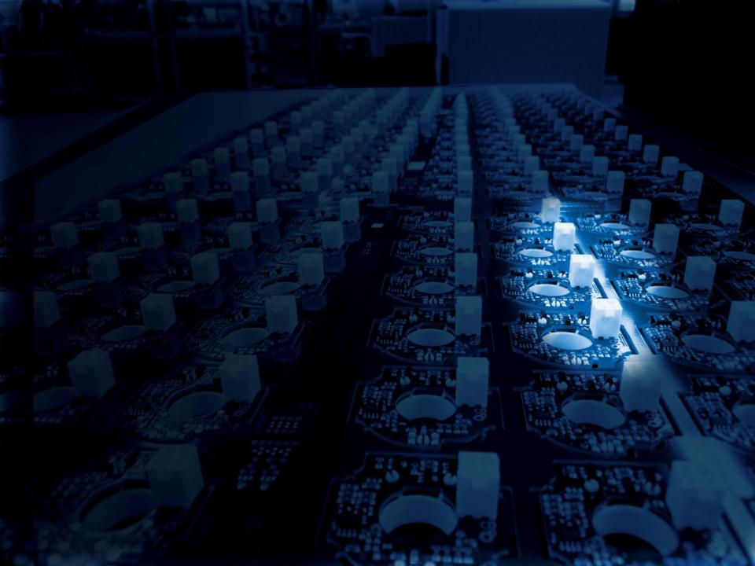


Why buying from LEM ?
2015

Slide 2
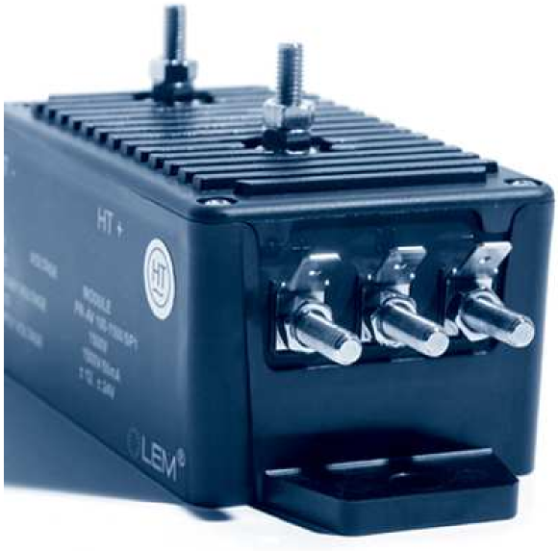
Why buying from LEM ?
 | 40+ years of Leadership Expertise Partnership Customer application know how Solid company World wide Coverage Local global service The largest Portfolio The right product for any application 0.3A to 24kA (nominal current) 6 to 6.4kV (nominal voltage) The right technology for any application R&D and innovation 73 engineers In house ASIC design Increased investment R&D 8 new products in 12/13
 | Quality Same quality around the world 5 years warranty High level qualification du to internal lab Manufacturing 4 plants in LCC for high volume in Geneva for High precision 10 Millions of products per year Industrial automated process Our positioning in the market W/W structure & local teams R&D and Innovation High Quality High Performance products High End

Slide 3
1 – 40+ years of Market Leadership
Since 1972 designing and manufacturing transducers
Grown to a world wide organisation
40+ years partnership with key customers
40+ years of expertise
  Transducer technologies (complete portfolio)
  Customer application know how
    Good understanding of our customer application, needs, requirements (Drives, Traction, solar, Wind. )
  Industrial norms, standards know how (EN 50155, EN 50178, IEC 61010, UL….)
  Strong expertise in Industrial design & manufacturing,
    IPD design to manufacturing process
    6 Sigma program around the world
    PPM manufacturing
World Wide company
  Financially solid
  Good diversification of business and geographic
  Strong partnership for the future

Slide 4
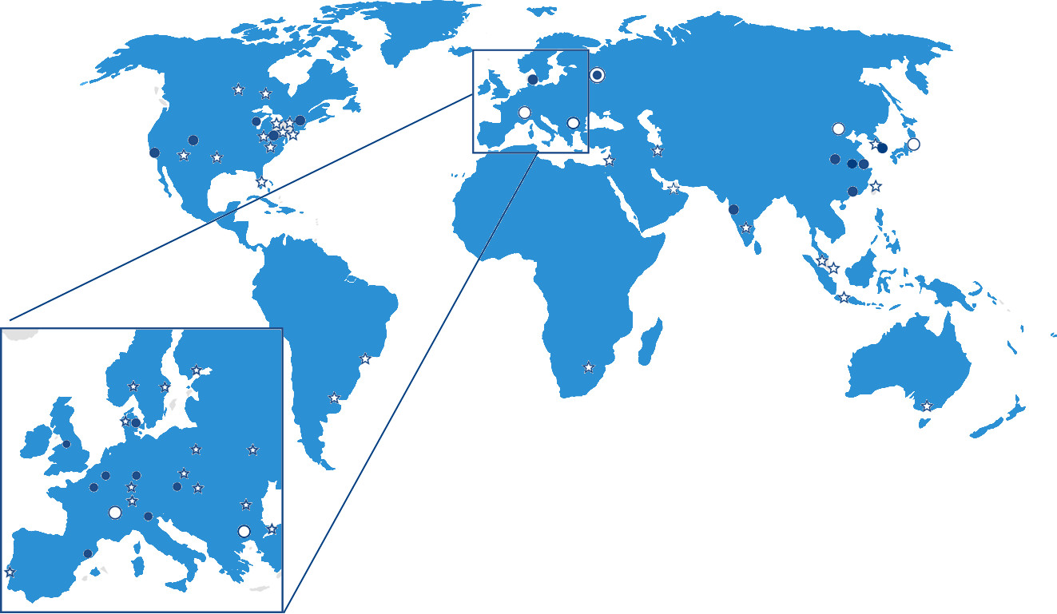
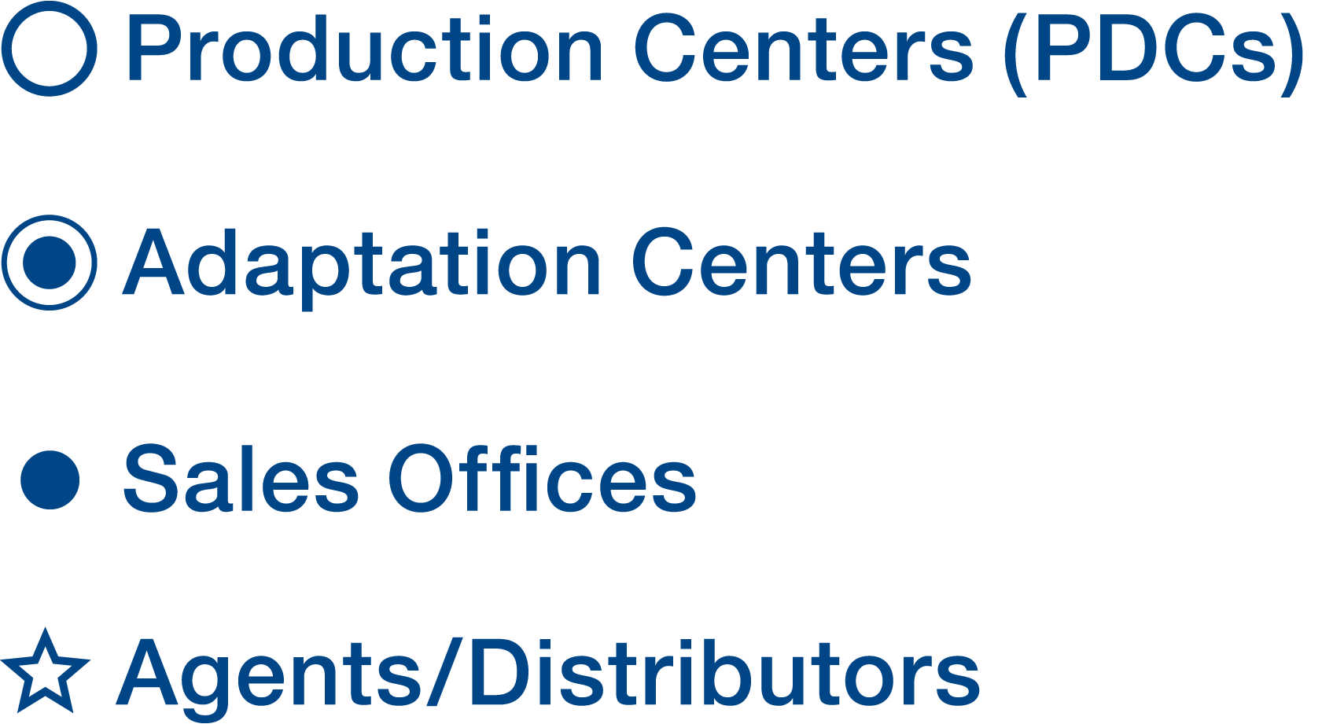
2 - Worldwide reach / Supplier of choice
Production Centers (PDCs)
Adaptation Centers
Sales Offices
Agents / Distributors
Global services with seamless presence for customers across all continents
  Technical support
  Sales (13 subsidiaries and 30 distributors)
  Logistic
Focus on operational performance
    4 factories: Geneva, Machida, Beijing, Sofia
Operational excellence to respond to customer requests and to enhance customer satisfaction

Slide 5
3 - Product/Technology Portfolio
3.1 - Largest Product Portfolio
  The right product for any application
  More than 2000 products
  More than 250 product families
  Current, Voltage, Impedance and Energy measurement
    Large Current/Voltage range (mA to A / V to kV)
    Large choice of connecting
    Several Mounting solutions (PCB Through hole or SMD, Panel…)
  One stop shop, all from one supplier
3.2 - Largest Technology Portfolio
  The right technology for any application
  (Open/Closed loop, Hall Effect/Fluxgate, Prime, CT, Split Core….)

Slide 6
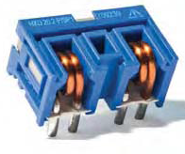
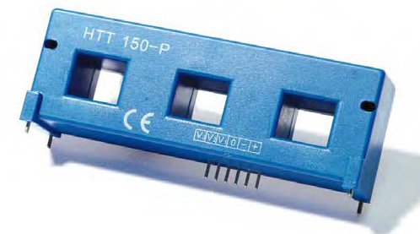
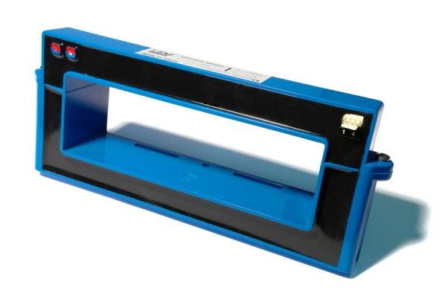
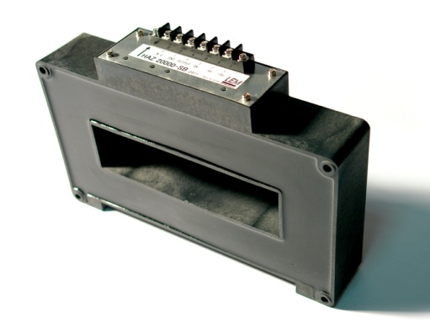
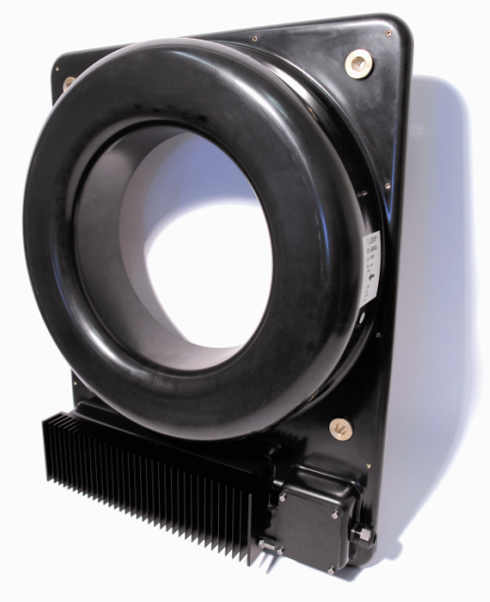
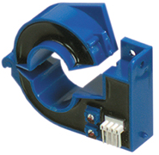
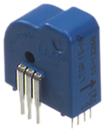
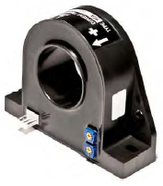
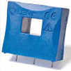
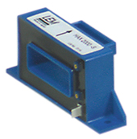
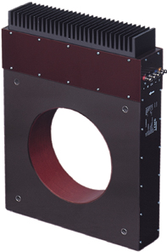
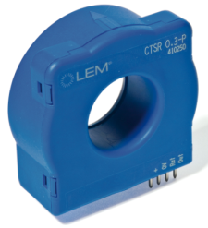
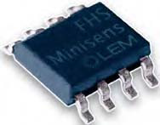
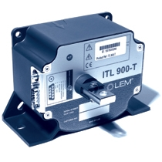
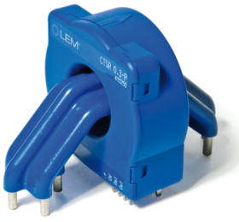
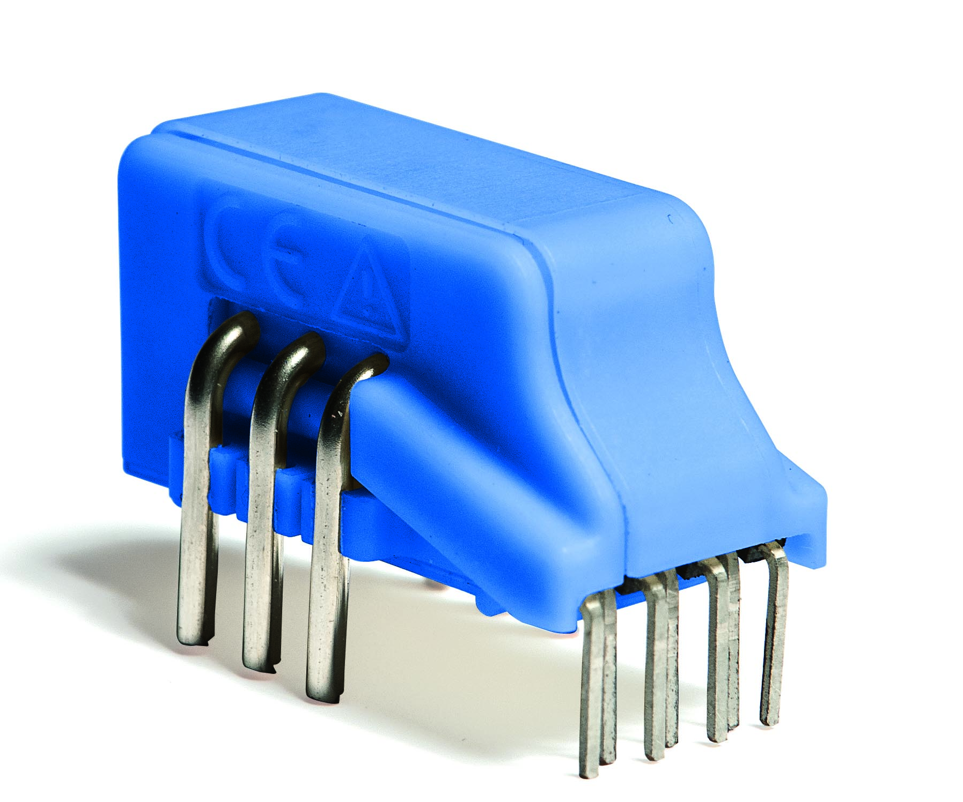
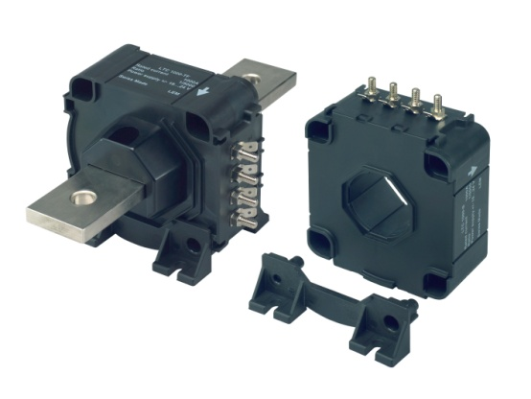
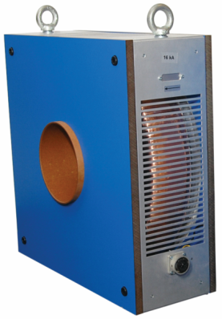
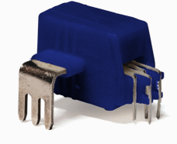
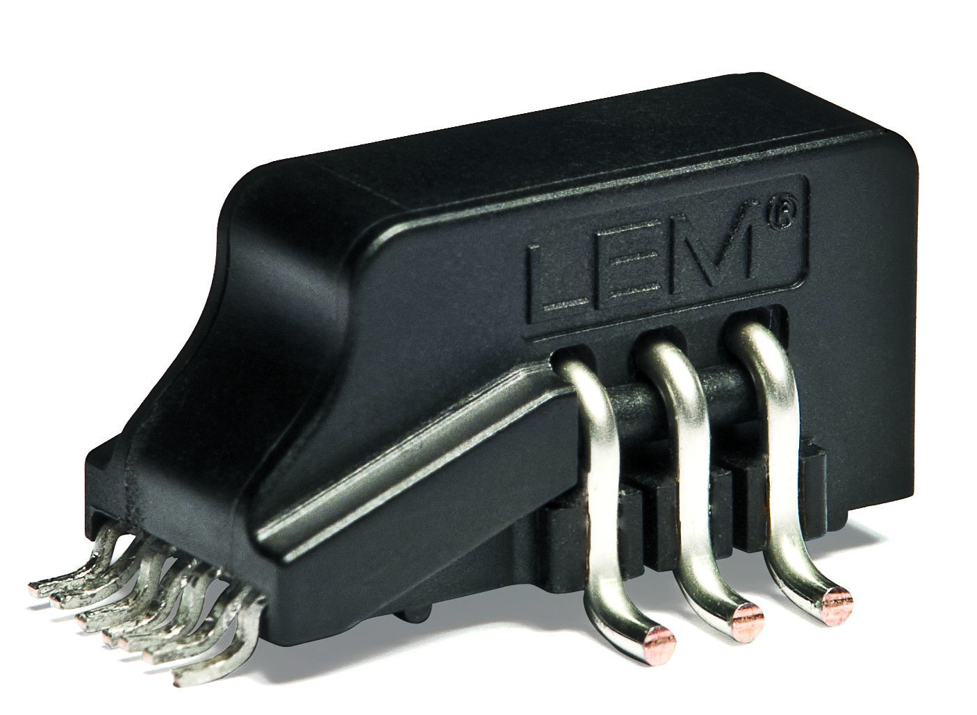
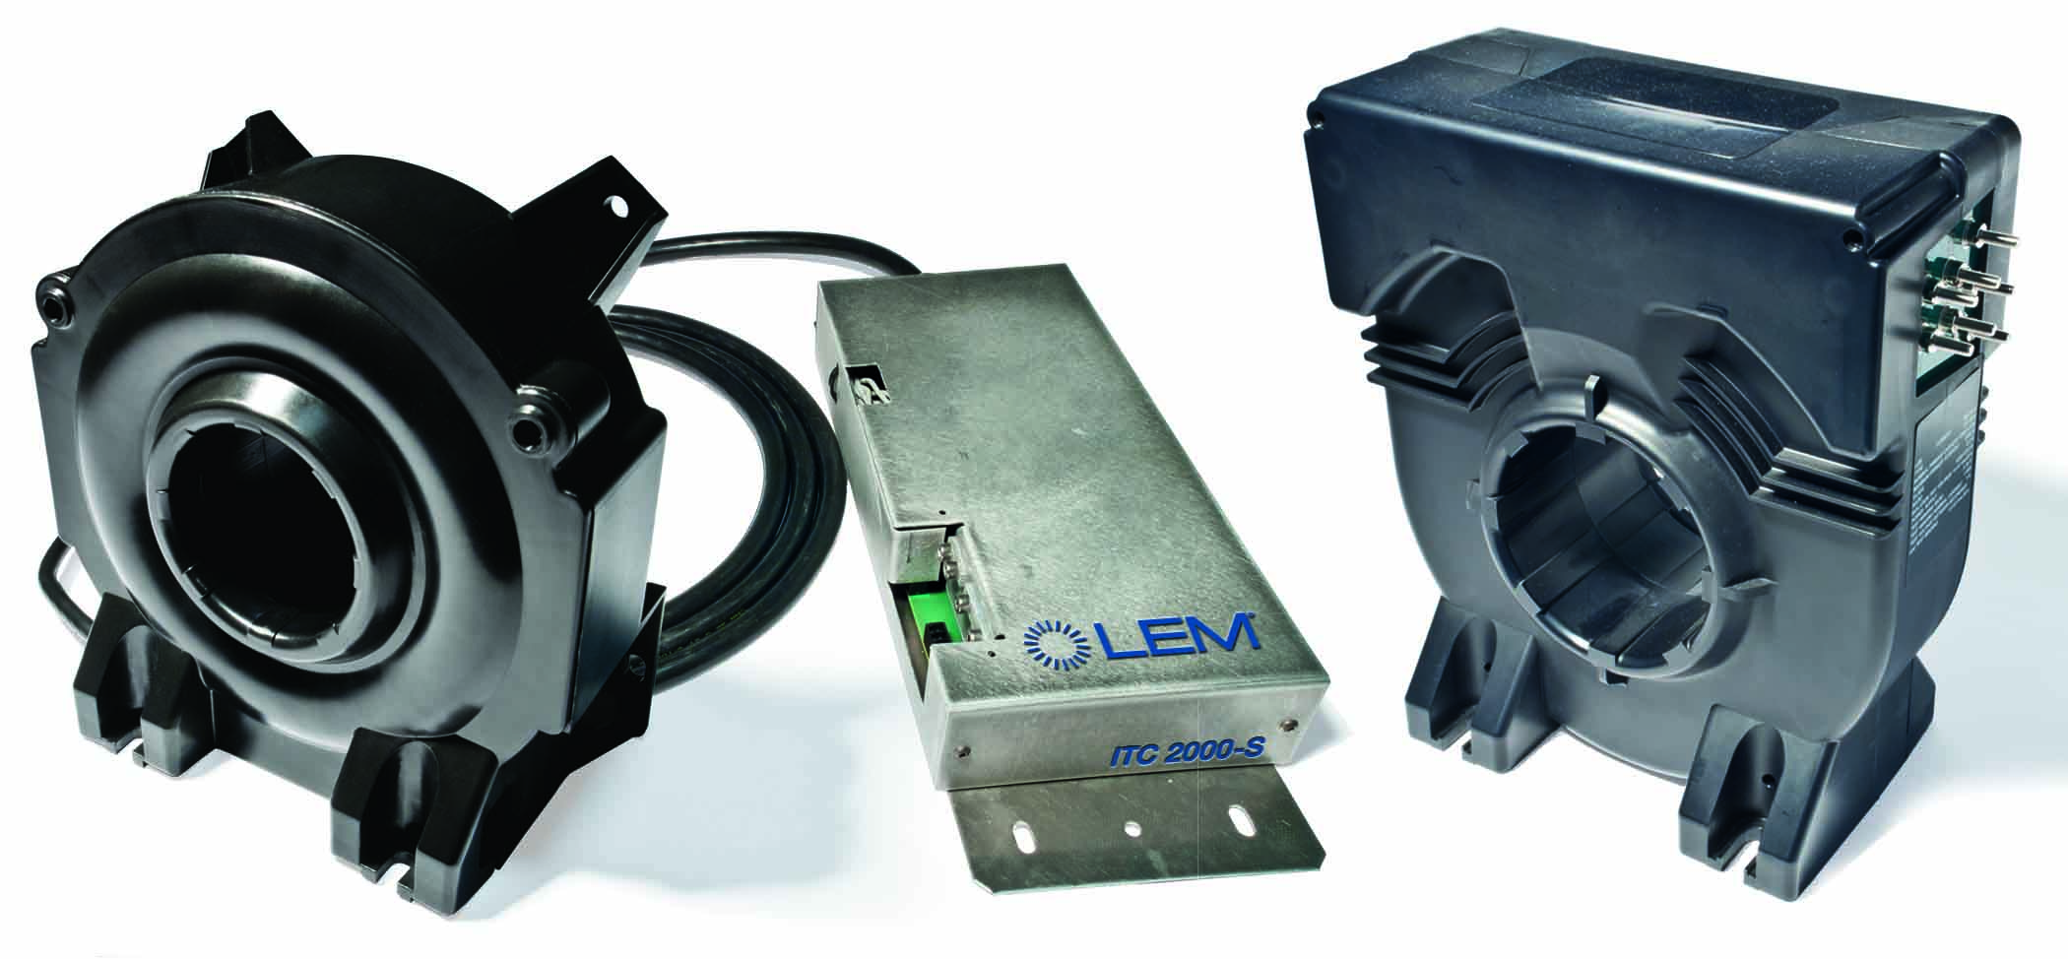
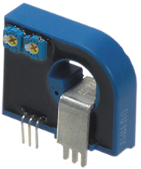
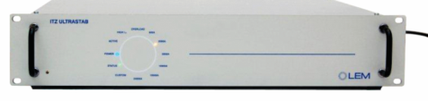
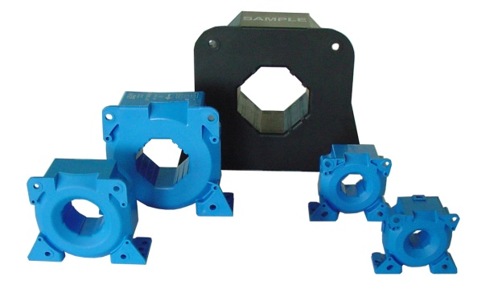

3.1 - Largest Product Portfolio
Current transducer range: 0.3A up to 24kA
I_{PN}
0.3A
1.5A
5A
50A
100A
500A
1kA
4kA
24kA

Slide 7
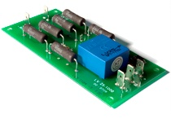
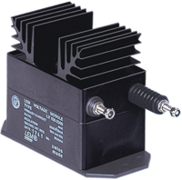
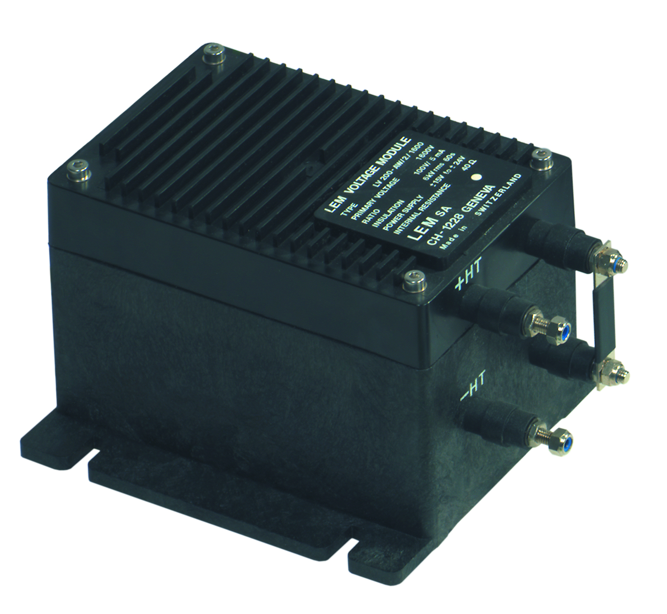
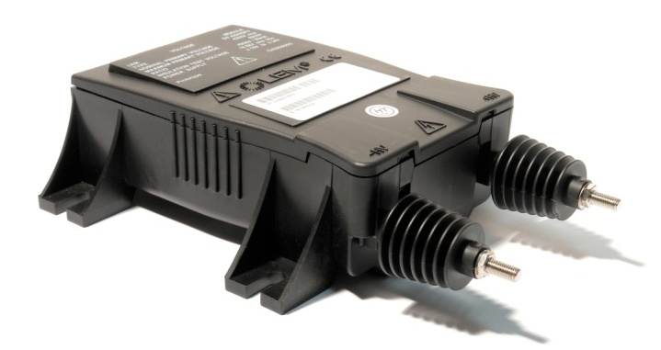
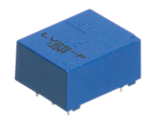
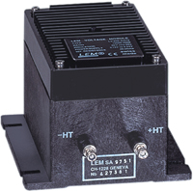
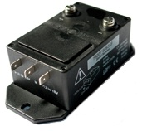
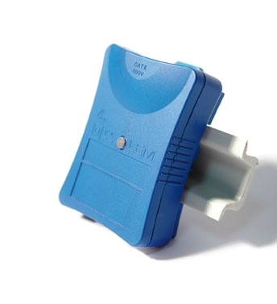
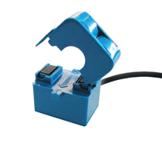
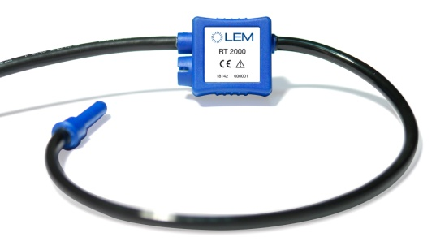
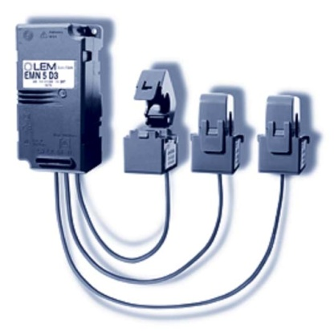
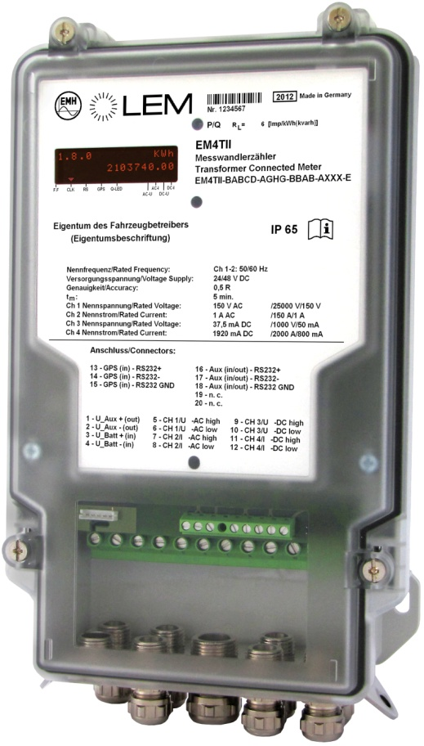
3.1 - Largest Product Portfolio
Voltage transducers range:
Battery Monitoring
      SENTINEL 2
      SENTINEL 3+
Energy Sub-metering
      Wi-LEM,
      EMN for OEM
V
10 V
100V
500V
1200V
2500V
4000V
4200V
6400 V
AC Transducers for Power & Metering application
      TT then TOP
      RT (Rogowski Coil)
    Energy Metering

Slide 8
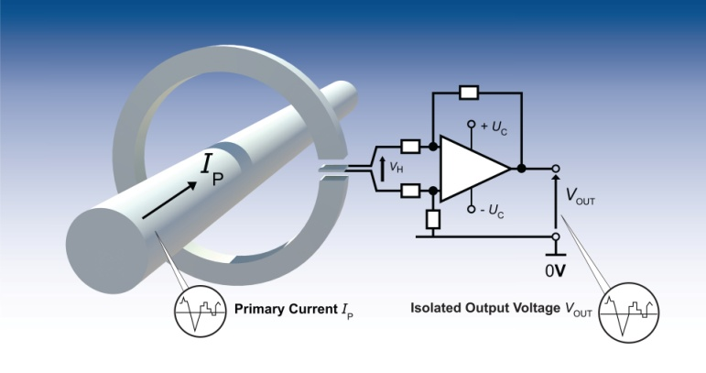
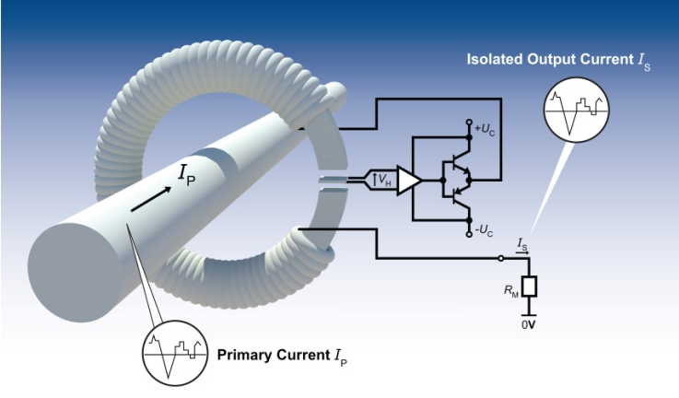
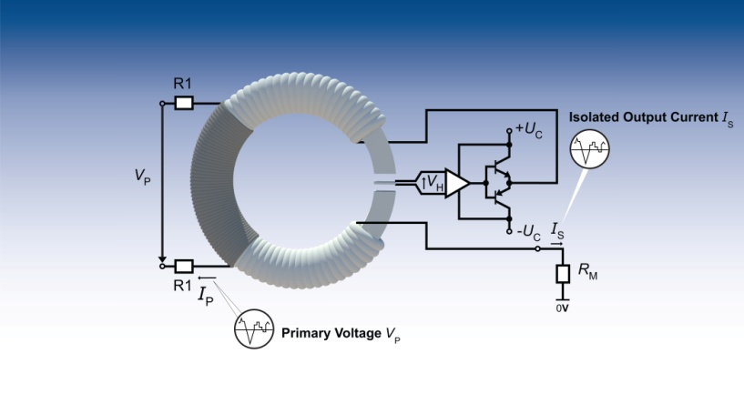
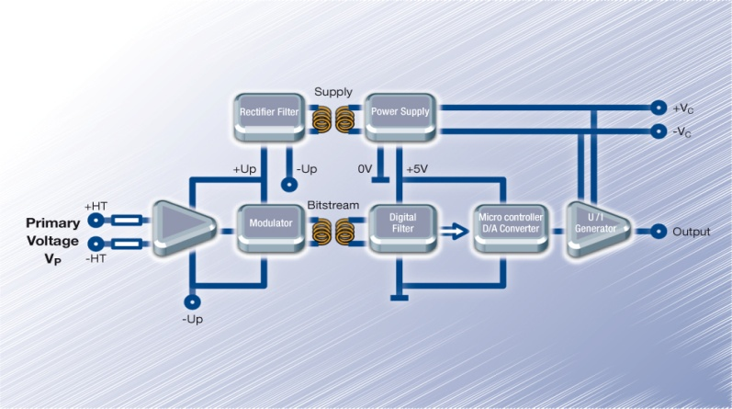
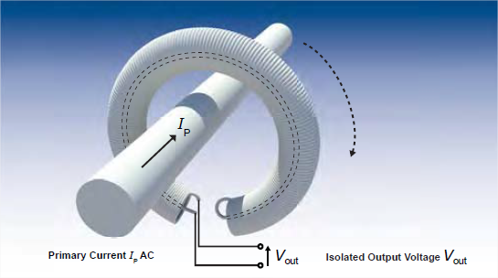
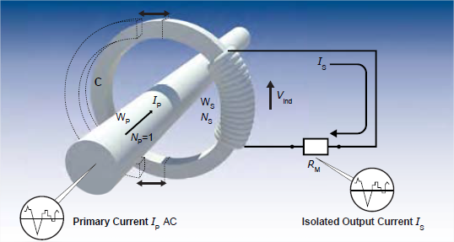
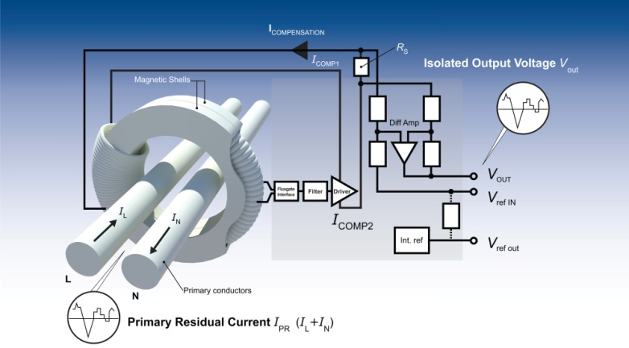
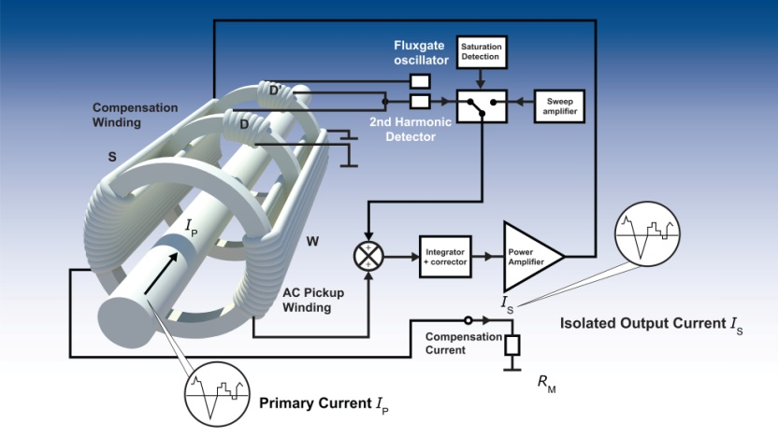
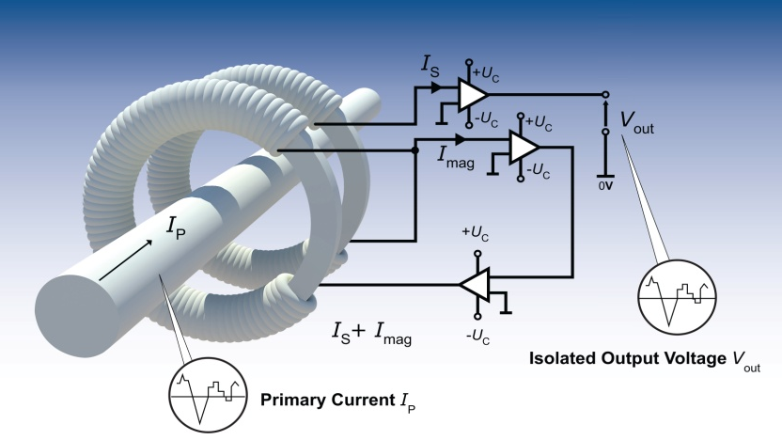
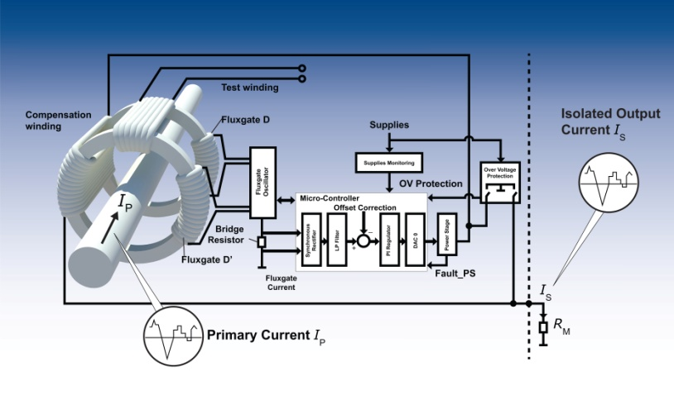



3.2 - Largest technology portfolio
Hall effect Current Transducers
Digital Voltage Transducers
Open Loop
Closed Loop
Closed Loop Fluxgate Current Transducers
Rogowski
Split Core
Prime
Notes:
Hall Effect
- Open loop and Closed loop products
Continue the product roadmap with ASIC’s on:
C/L @ 5V focus on accuracy and cost
O/L @ 3.3 + 5V focus on accuracy and cost
Digital output
Fluxgate
- C/L – products for voltage & current
Integration with ASIC
Big current & voltage with Micro controller
Very high accurate transducers
Rogowski
Used for split-core AC
PRiME (Air-core)
Used for AC

Slide 9





4 - R&D and innovation
Dedicated engineering teams
  73 engineers
  Dedicated multidisciplinary innovation team
  In House Asic Design
Main objectives:
  Renewal of product range
  Focus on optimized cost
  Focus on higher accuracy
  New functions/Technologies
  Constantly improve performance of products
Increased investment in R&D (#5.5% of sales)
Increased number of product launches
  8 new products in 12/13
  secure 11 new patents

Slide 10

5 – Quality
LEM Switzerland :
ISO 9001 since 1993
TS 16949 since July 2002
ISO 14001 since December 2003
IRIS since September 2007
Same quality everywhere around the world
    Swiss quality
LEM China :
ISO 9001 since 2002
ISO 14001 since end 2006
ISO TS 16949 since September 2007
IRIS since August 2008
LEM Bulgaria :
On going
TVELEM (Russia) :
ISO 9001 since 2003
LEM Japan :
ISO 9001 since 2003
ISO 14001 since 2006
Best service, quality and cost
    World class supplier
    Kaizen, Six sigma, OTD, ppm, …
  Single digit ppm on full-automated products
LEM warranty: 5 years
    (other industrial players : 1 or 2 years)

Slide 11



5 – Quality / Qualification capabilities & Standard expertise
DC Current
  up to 10kV DC or 15kA DC
AC - high frequency
    up to 100kA pulse
dI/dt, dV/dt
Partial discharges
Isolation
      up to 12kV
Temperature & humidity cycles
  (-80°C / +180°C)
Thermal shock (-60°C / +190°C)
Vibrations
  (5 to 2000Hz, up to 10kN and 100g)
EMC & ESD

Slide 12


6 - Manufacturing
4 Manufacturing plants
  in Low Cost Country for High Volume
  High precision and high added value in Geneva
  > 20’000 square meter facilities
  > 10 millions products per year
High qualification operators
Flexibility between teams and production lines
Industrial automated process with full automated production for high volume

Slide 13

7 – Our positioning on the market
W/W
Regional
World/Wide
R&D
“Copy”
Innovation
Quality
Low Quality
High Quality
Product’s features
Low Performance
High Performance
Customer Market
Low End
High End

